Slide 1

Pinnacle Performance Enhancement Solution for DHL
A Brief Synopsis of
The System’s “Look & Feel”

Slide 2
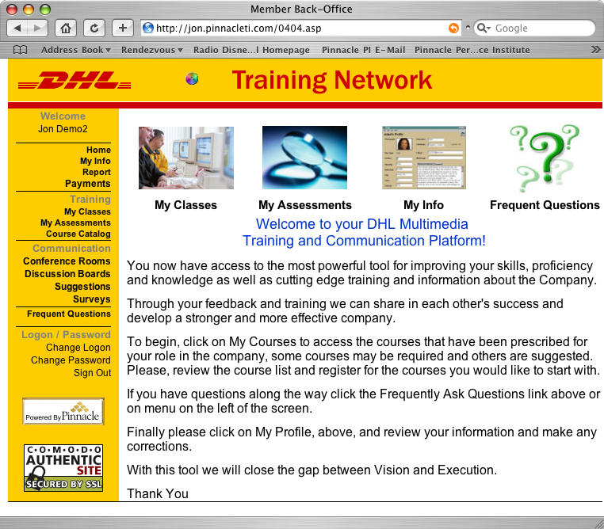
Pinnacle Performance
Enhancement Solution
The private labeled DHL Performance Enhancement Solution is designed to accomplish 3 Primary Objectives:
  Provide Metrics on Strengths and Weaknesses.
  Build Confidence and Competence.
  Facilitate effective communication throughout the entire organization.

Slide 3
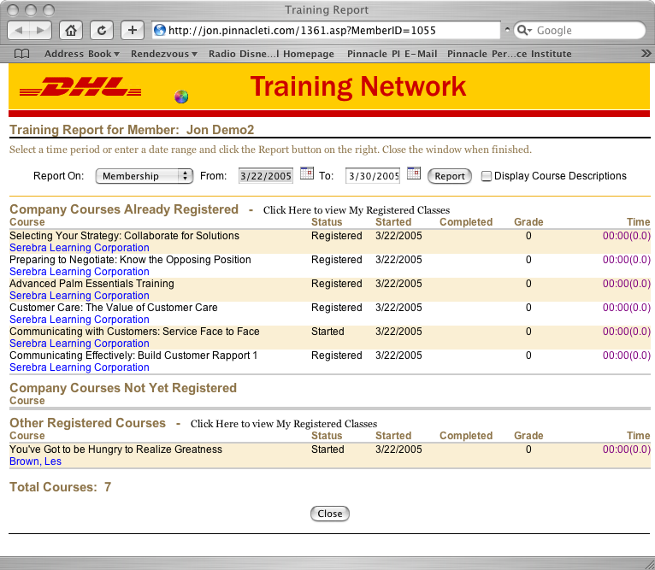
Pinnacle Performance
Enhancement Solution
The “Training Buddy” will greet and engage members on their activity and status
Members can view specific reporting on personal activity in a Registrar format
Reporting includes courses completed, courses started, certifications, etc…

Slide 4
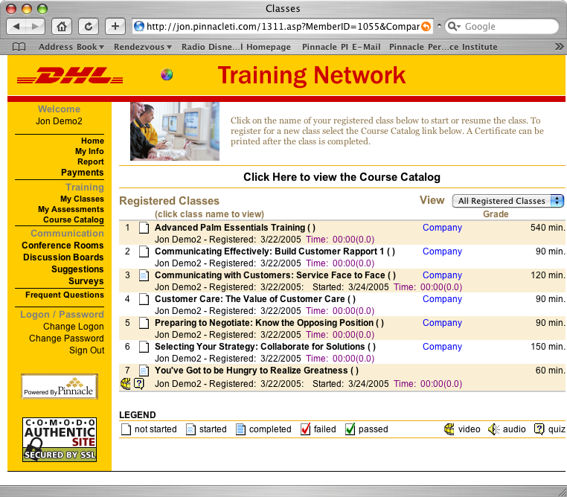
Pinnacle Performance
Enhancement Solution
The My Classes page shows courses that a member is registered to take and has taken
Information on each course depicts the type of course and status of each course - i.e. not started, started, completed, passed, etc…
Category of the courses - Public or Company - is also depicted

Slide 5
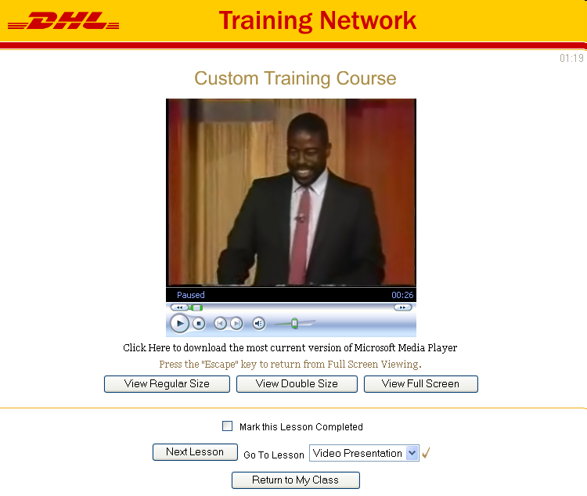
Pinnacle Performance
Enhancement Solution
Courses can be viewed in various multi-media formats including Streaming Video, Static Slides, Flash Graphics, or a combination
Courses that have been captured on video can be digitized and simply uploaded by DHL’s System Administrator
Streaming Video viewing provides the flexibility to pause and repeat course material for true self-paced learning

Slide 6
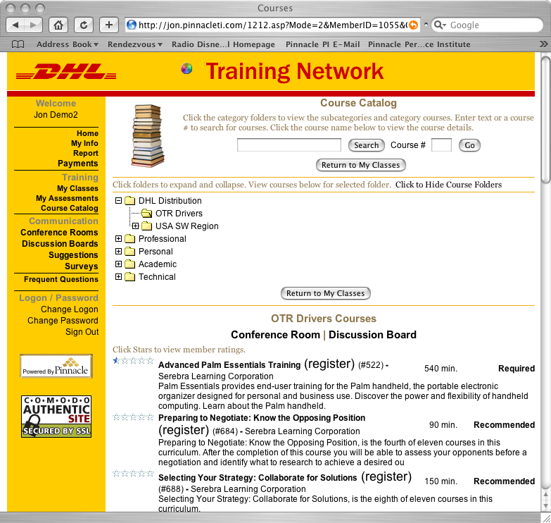
Pinnacle Performance
Enhancement Solution
The Course Catalog page lists the courses assigned to the member’s Course Folder(s)
Both the private Company Course Folder and the Public Course Library folders of courses are displayed
The Course Catalog provides current ratings and a brief description of each course

Slide 7
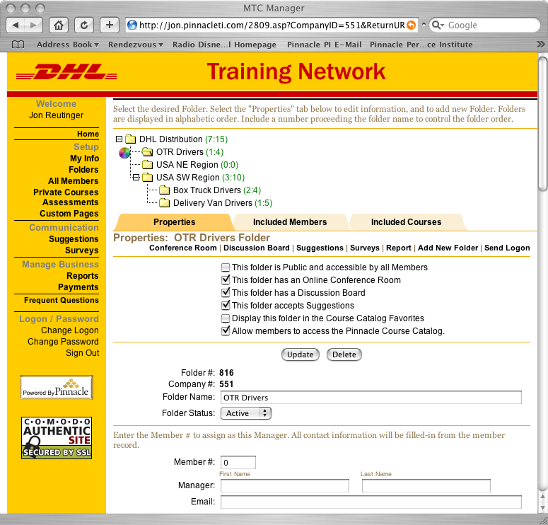
Pinnacle Performance
Enhancement Solution
Management and Maintenance of the entire Performance Enhancement Solution can be done INDEPENDENTLY within a Virtual Back Office
The Virtual Back Office can be managed by a single Administrator and/or decentralized to Folder Mgrs.
Training Folders can be added or deleted on an on-going basis

Slide 8
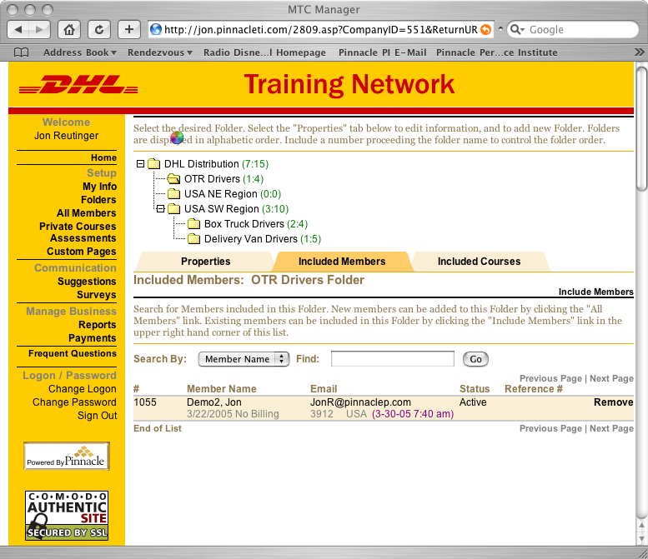
Pinnacle Performance
Enhancement Solution
Members can be assigned to a specific Training Folder or several Training Folders based on role, status, new skill certification needs, etc…
New members can be added on an on-going basis
Members can be assigned to Training Folders to deliver training with Pin-Point Accuracy

Slide 9
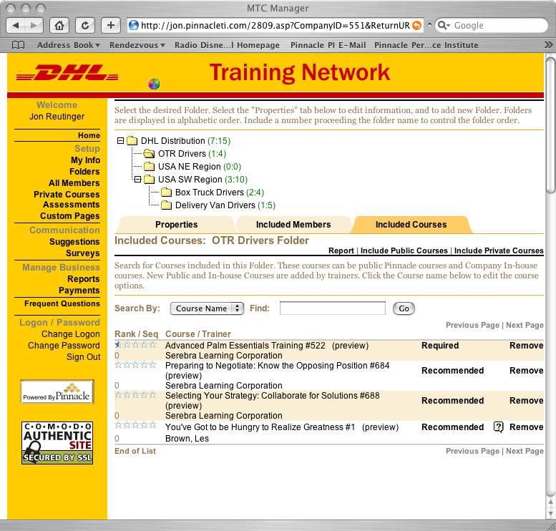
Pinnacle Performance
Enhancement Solution
Courses are designated to specific Training Folders accurate to the training needs of each category of members
Courses from both the Public and private Company Course Catalogs can be included and designated as Required or Recommended
Company Courses are simply uploaded and included in the Private Catalog

Slide 10
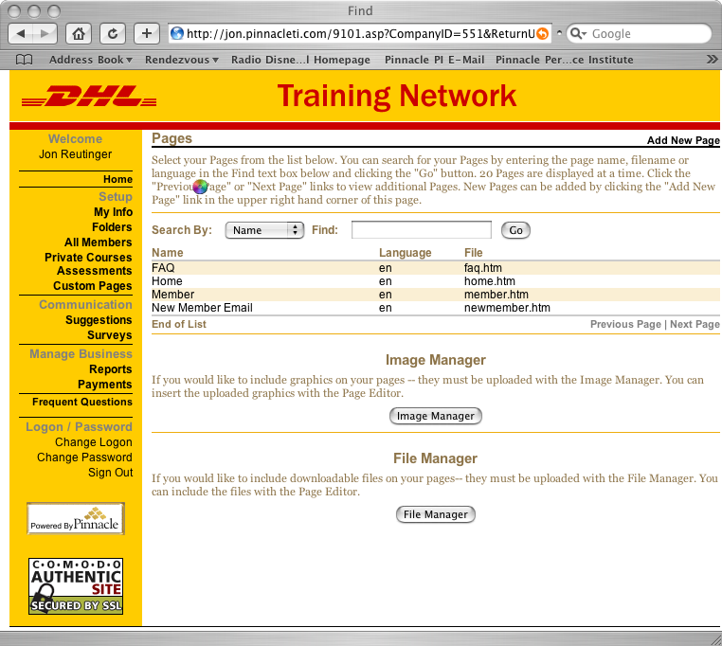
Pinnacle Performance
Enhancement Solution
All Pages within the system can be customized to DHL’s look, feel and functionality
Additional Pages can be added to the system
Multi-media communications can be embedded into pages
Commonly used documents can be linked-in for download when needed

Slide 11
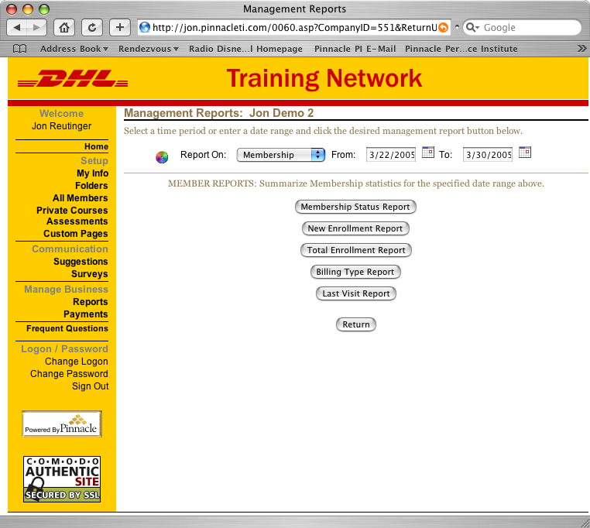
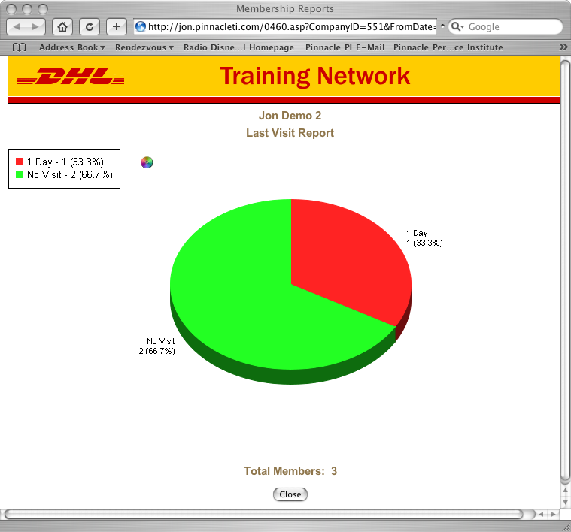
Pinnacle Performance
Enhancement Solution
System Administrators and Folder Managers can instantly receive reports on a multitude of Performance System Metrics
Reports can be customized to suit the needs of DHL
Reporting can be done in graphic or detailed list format
Reports can be scheduled to run automatically to provide information for other DHL systems

